Slide 1
A Very Brief Overview
of
Maharishi AyurVeda

Slide 2

Maharishi AyurVeda
The 3 Doshas
Notes:
From the perspective of Ayurveda, the human body and all of its functions are governed by these subtle types of energy or functioning principles. They create our mind-body type.

Slide 3


Earth
Everything in creation is made up of 5 elements,
including us. Each one of us is a unique combination
of these elements – and the basic types of energy
or functioning principles that are present in them.

Slide 4



The Doshas—Vata, Pitta, and Kapha
Vata has the characteristics of air and space,
is light, and is responsible for movement.
Pitta has the characteristics of water and fire, is hot, and is responsible for digestion and metabolism.
Kapha has the characteristics of earth and
Water, is heavy, and is responsible for structure
and lubrication.

Slide 5

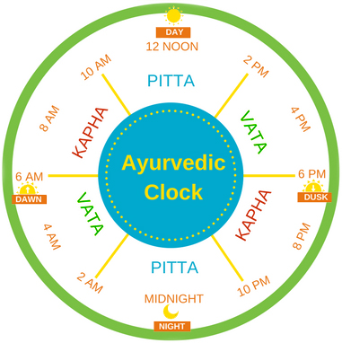
The Times of Day
The Seasons
Notes:
The three Doshas govern and are seen in the different times of day, in the seasons of the year: as well as in our individual physiologies.
Aligning the rhythms of individual life to the rhythms of nature is beneficial for all aspects of mental and physical health.
For example, following the Ayurvedic daily routine of rising before 6:00 am, Vāta time, brings with it the qualities of Vāta—lightness, freshness, alertness, and quickness.
Sleep is aided by going to bed before 10:00 pm, Kapha time, taking advantage of the heavier, settling influence of Kapha

Slide 6
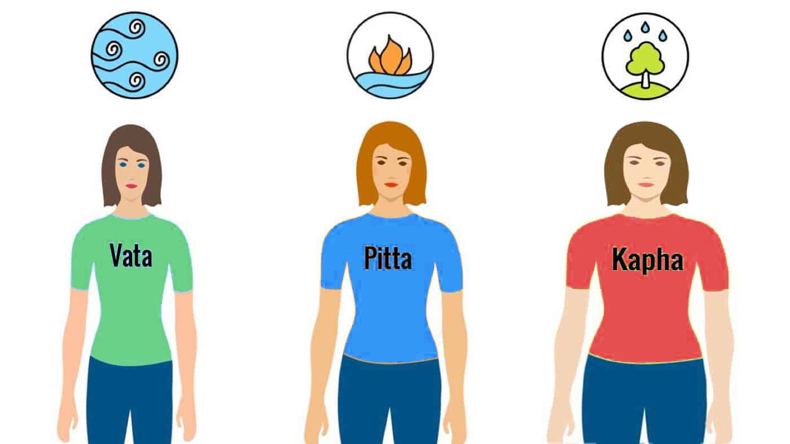
Your dosha makeup, or prakriti, determines everything from the shape of your body to the way your mind, emotions, and body work.
It is your underlying, unique nature.

Slide 7



Slide 8


Slide 9



Slide 10


Slide 11



Slide 12


Slide 13
Maharishi AyurVeda
Positive behaviors that enhance health,
happiness and longevity
Behavioral Rasanyanas

Slide 14
Maharishi AyurVeda
Behavioral Rasanyanas
1. Maintain a positive, calm outlook.
2. Practice cleanliness of all kinds.
3. Be charitable with your time, your attention, your actions, and your finances.
4. Follow the precepts of your religious or spiritual beliefs. Meditate regularly. Be devoted to knowledge and developing higher states of consciousness.

Slide 15
Maharishi AyurVeda
Behavioral Rasanyanas
5. Be loving and compassionate.
6. Always speak the truth, but speak sweetly. Speak well of others. Speak in a way that uplifts people. Avoid harsh or hurtful speech and speaking ill of others behind their backs
7. Perseverance
8. Avoid conceit, pride, arrogance, egotism, or selfishness

Slide 16
Maharishi AyurVeda
Behavioral Rasanyanas
9. Be free of anger, violence, and hostility
10. Moderation and self-control in any activity that can lead to imbalances
11. Avoid coveting another's possessions

Slide 17
Maharishi AyurVeda
Behavioral Rasanyanas
12. Culture humility, innocence and simple, guileless behavior. Avoid dishonesty or duplicity
13. Have respect toward teachers, parents and elders
14. Keep the company of the wise, of people who uplift and bring out your best.

